Slide 1
How to Search for Data
2019 AMOS Darwin
Kate Snow & Jingbo Wang

Slide 2
Geonetwork
CMIP Website
ESGF Site
CleF
Data Download Requests

Slide 3
Key Takeaways...
Know where to go to search for data hosted at NCI:
https://geonetwork.nci.org.au
The options available to access data
Remote access options
In-situ on filesystem
How to request to join data projects (for closed data collections)

Slide 4
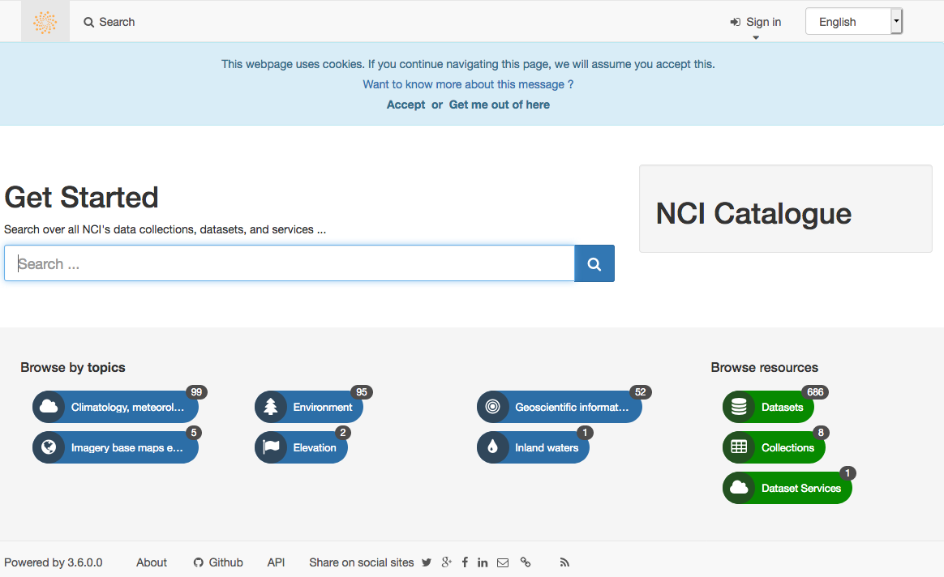
New Geonetwork: https://geonetwork.nci.org.au
A new NCI Geonetwork catalogue has been released this month!
The new version permits improved search options, clearer user information (such as project paths) and more detailed metadata.

Slide 5
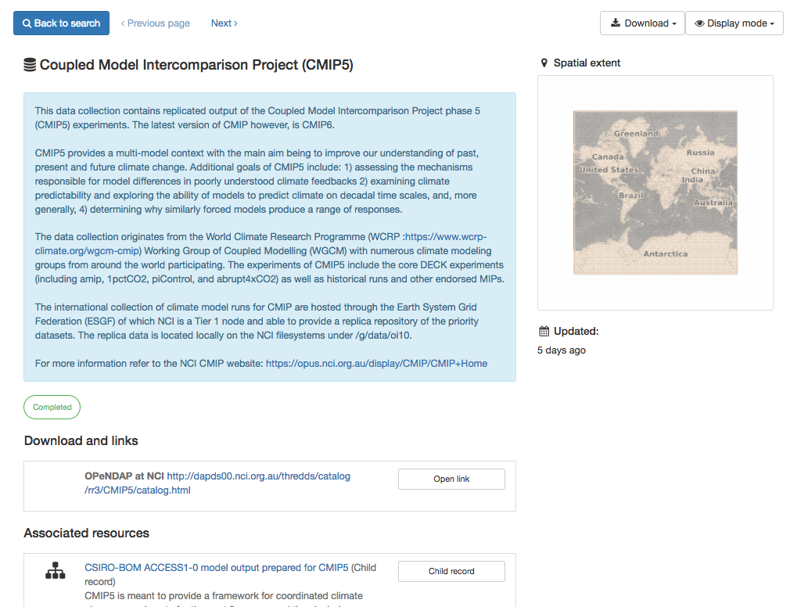
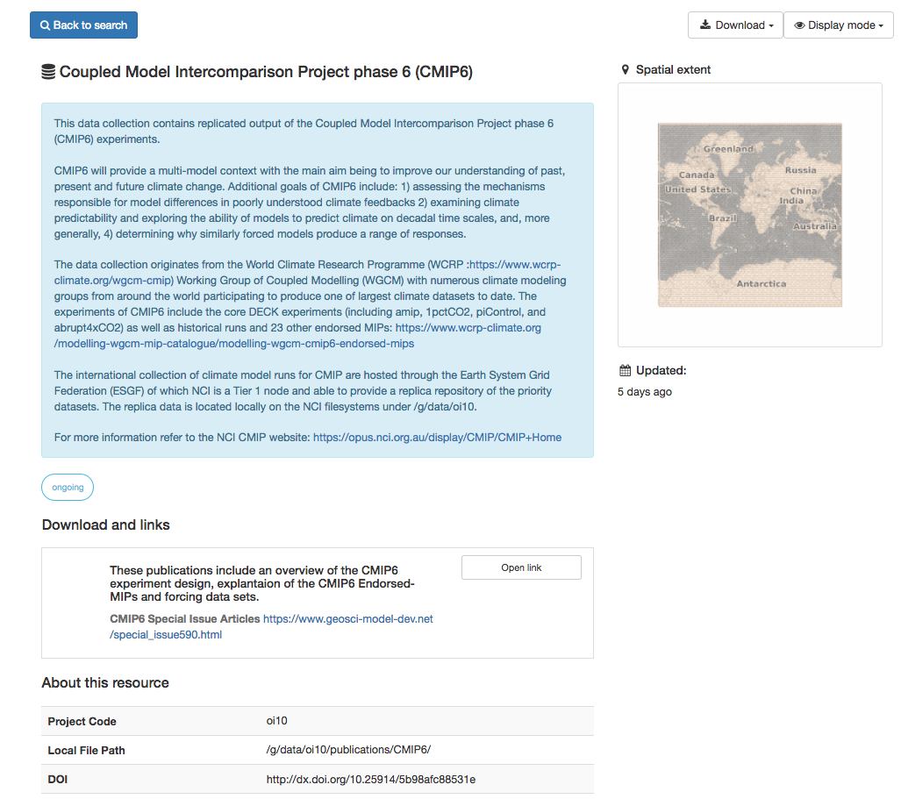
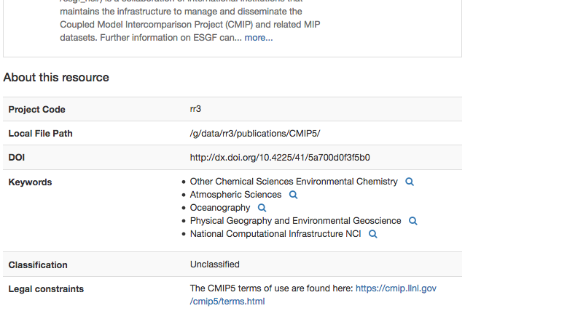
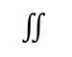
Accessing data
When searching and browsing data, published collections will have a direct link to NCI’s Data Services.
Datasets are stored within data subcollections and collections as parent-child relationships
Information on filesystem location immediately available
$$∬$$

Slide 6
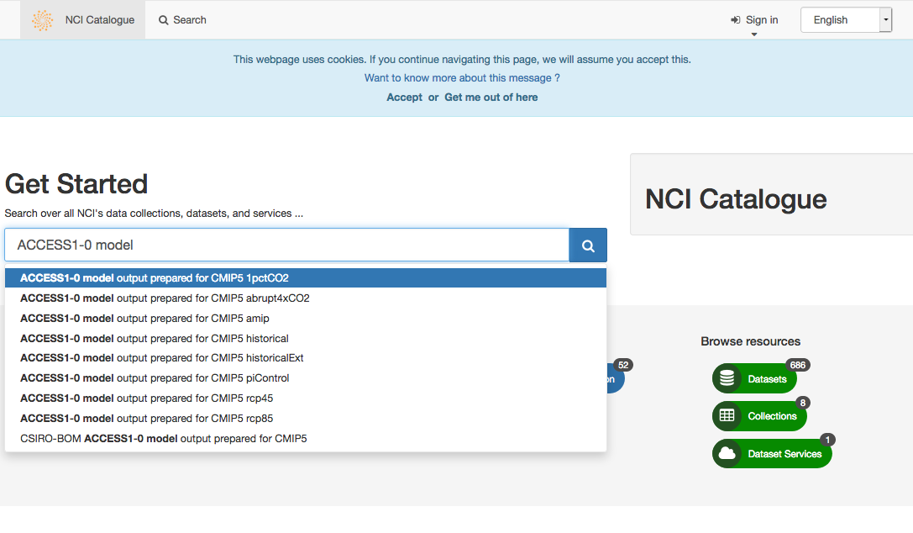
Exercise
Browse data catalogue for CMIP5 datasets: https://geonetwork.nci.org.au
Try to searching “ACCESS1-0 model...”
Have a quick look at the type of information contained, the parent/child records, etc.

Slide 7
Geonetwork
CMIP Website
ESGF Site
CleF
Data Download Requests

Slide 8
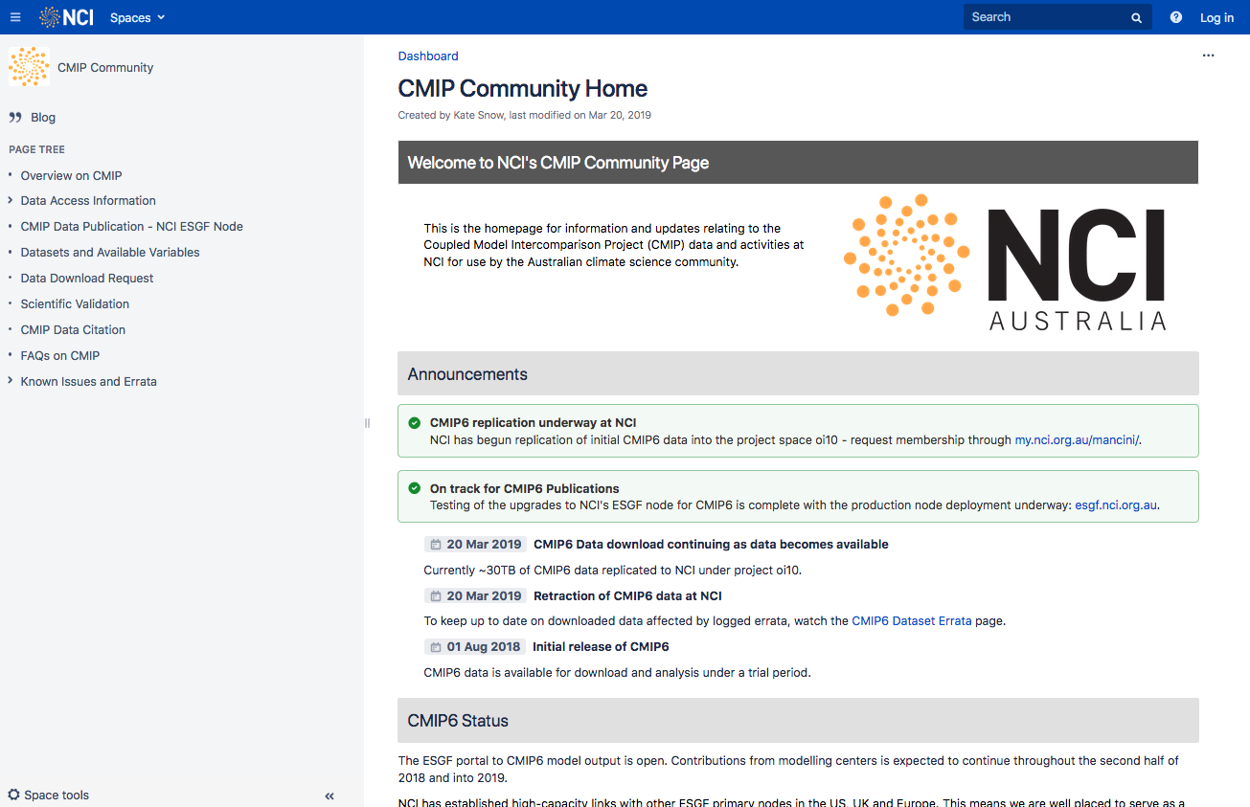
CMIP Community Site
https://opus.nci.org.au/display/CMIP/CMIP+Community+Home
Community information page on CMIP data. Includes announcements, user guides, data access information, etc.
Publicly viewable.
Central source of information for all CMIP relate activities at NCI.

Slide 9
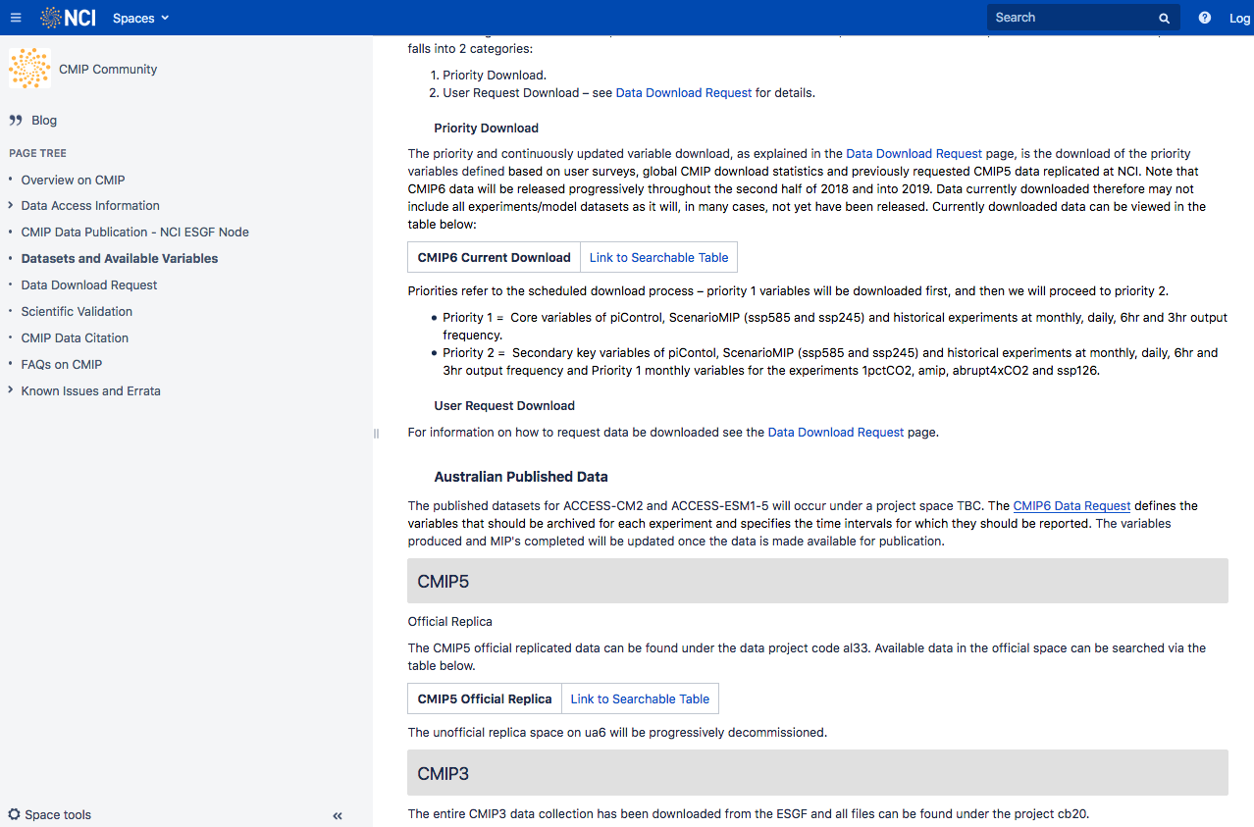
Available Data and Searchable Tables
Information on replica datasets downloaded to NCI is contained on the “Datasets and Available Variables” page.
Includes searchable tables updated weekly on data both downloaded and in the download queue.

Slide 10
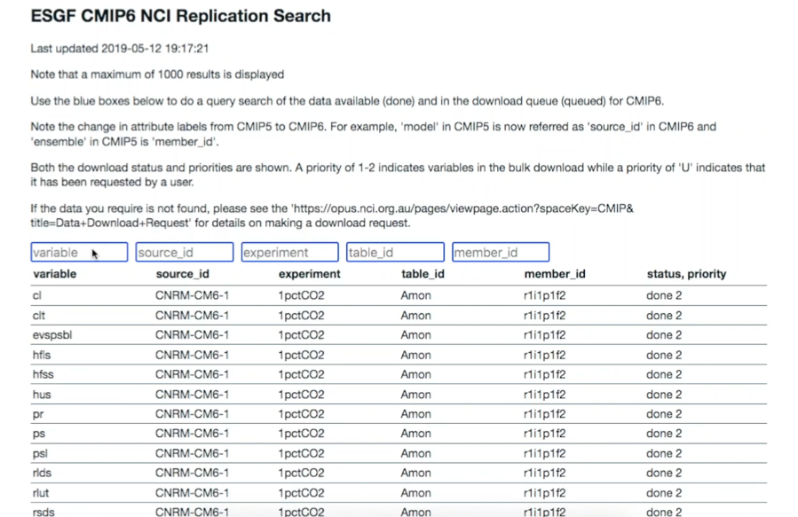
Demo
Table is updated weekly
Includes download status and priority
Relies on attribute search (more on CMIP attributes later).

Slide 11
Geonetwork
CMIP Website
ESGF Site
CleF
Data Download Requests

Slide 12

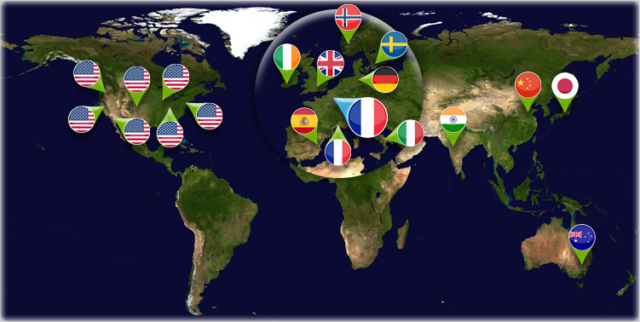
NCI ESGF Site
CMIP data is distributed via the Earth System Grid Federation (ESGF): a collaboration of internationally distributed data nodes.
NCI manages the ESGF Tier 1 data repository that serves the Australian climate science community.

Slide 13
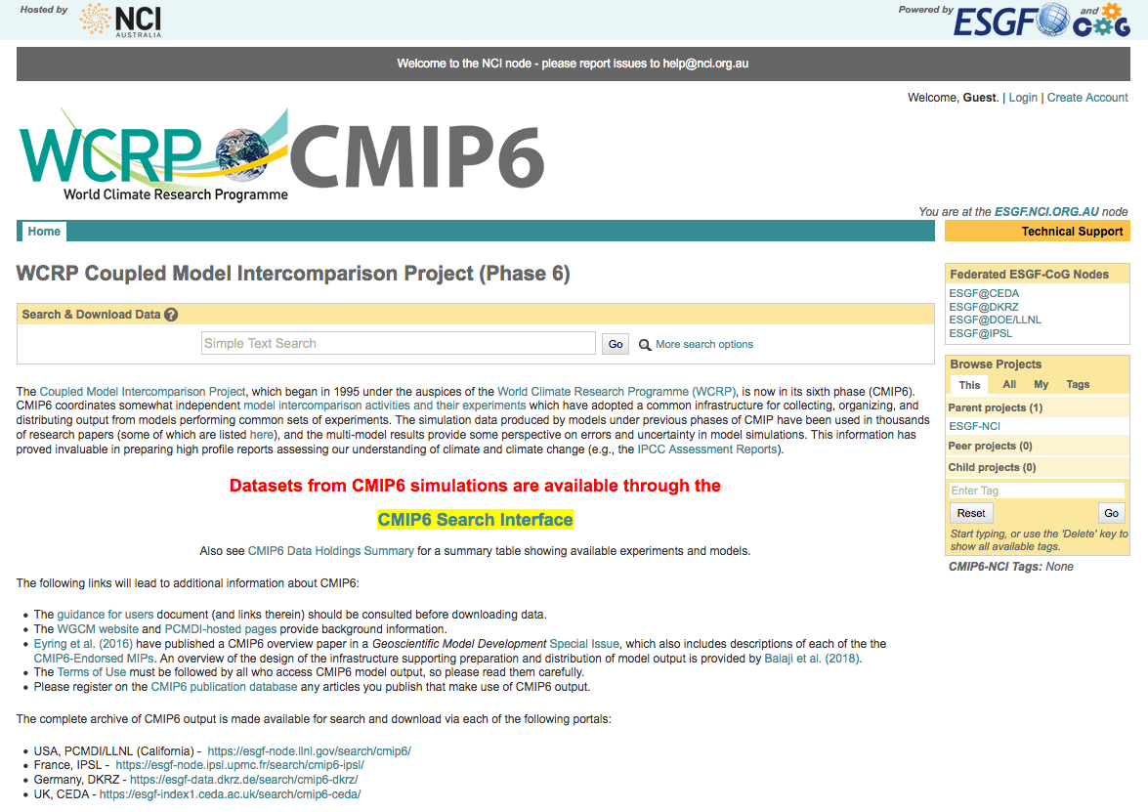
NCI ESGF Site
Data published via ESGF can be searched from the node sites.
https://esgf.nci.org.au/
Or just Google search “NCI CMIP5/6 ESGF”
Click to go to search interface

Slide 14
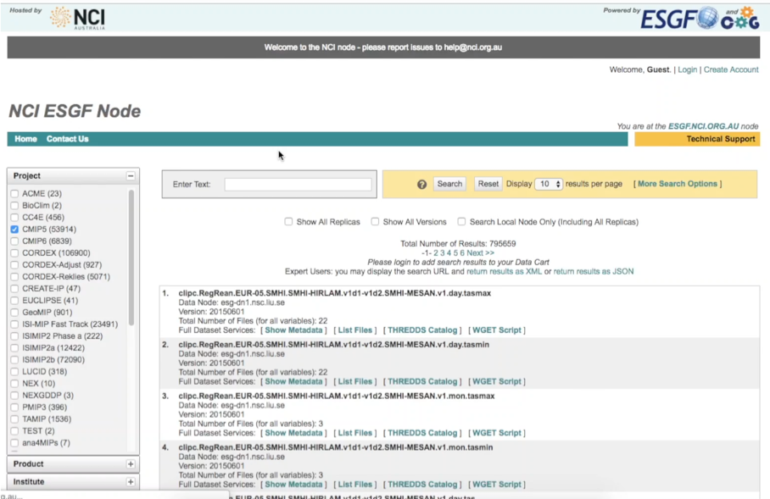
NCI ESGF Site
Keyword Search
Attribute search on LHS tabs
Search particular node publications/replicas
View metadata/THREDDS catalogue
View retracted data under “Show All Versions”

Slide 15
Geonetwork
CMIP Website
ESGF Site
CleF
Data Download Requests

Slide 16
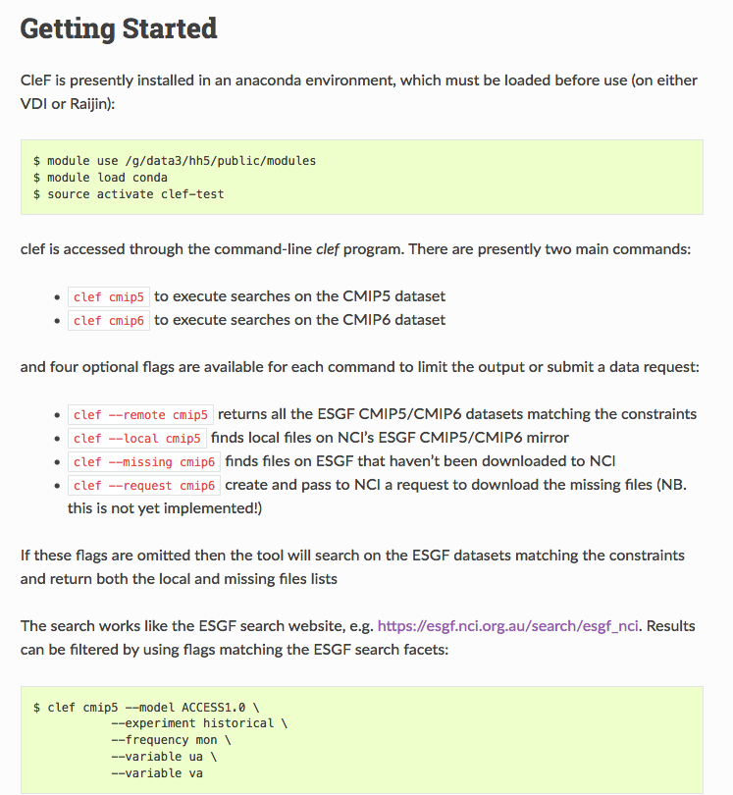
Climate Finder (CleF)
CleF is the Climate Finder tool developed by CLEX https://clef.readthedocs.io/en/latest/gettingstarted.html
Be aware that CleF is a tool under active development and changes/updates may occur.
Example to follow. Load the module.

Slide 17
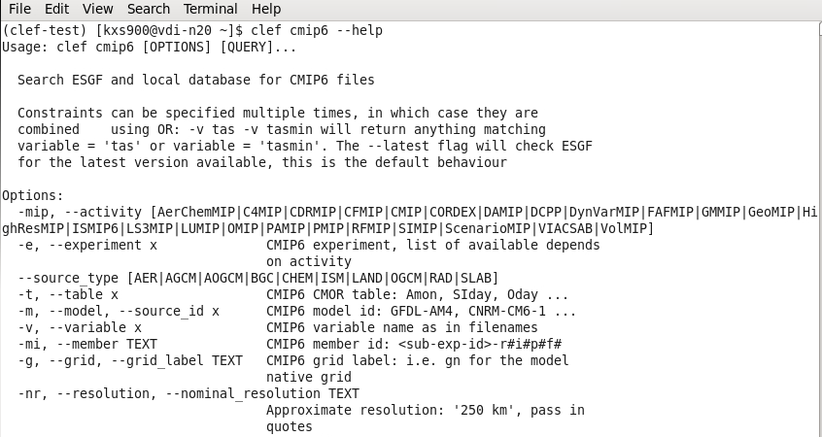
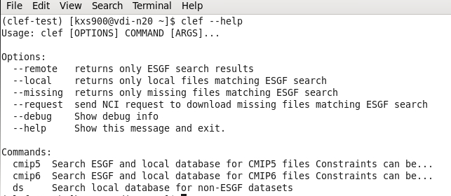
Climate Finder (CleF) Example
Returning help messages to list usage and available commands/parameters.

Slide 18
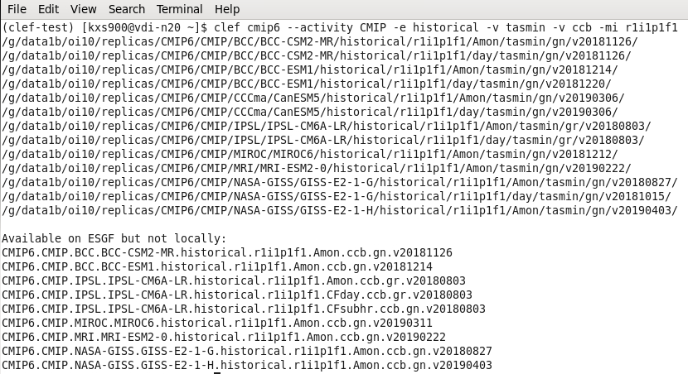
Climate Finder (CleF) Example
Searching for a specified dataset.

Slide 19
Geonetwork
CMIP Website
ESGF Site
CleF
Data Download Requests

Slide 20
Climate Finder (CleF) Data Download Request
Once you have completed a search using the CleF tool, a data download request may be made if you have the determined the data to be of high priority and required for your research.
To submit a request for the data to be downloaded, add “--request”
So from previous example, it becomes:
$ clef--request cmip6 --activity CMIP -e historical -v tasmin -v ccb -mi r1i1p1f1
Requests from the VDI will be emailed to help@nci.org.au. Requests from Raijin need to be manually emailed.

Slide 21
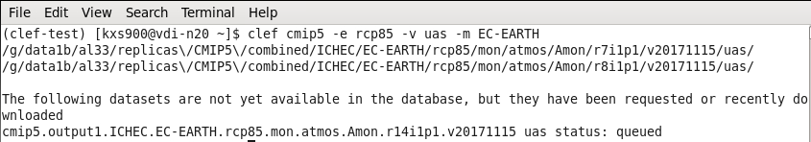
Climate Finder (CleF) Data Download Request
You can see the data being downloaded using CleF which also contains the information on data in the download queue.
Further CleF training: https://climateextremes.org.au/cms-training-clef-discovering-cmip6/

Slide 22
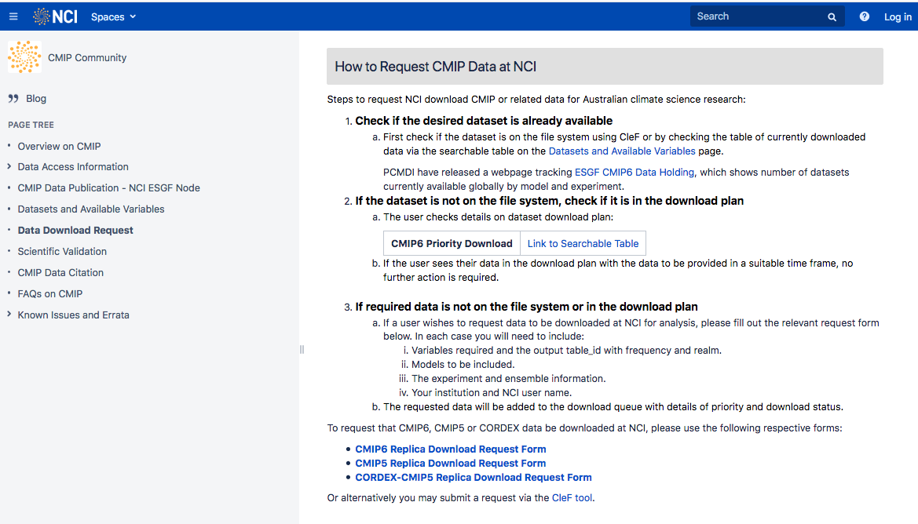
CMIP Website Download Request
You can also request to have data downloaded from the CMIP Community Site
Ensure you have searched for the data BEFORE making a download request
Can request CMIP5, CORDEX and CMIP6 data.

Slide 23
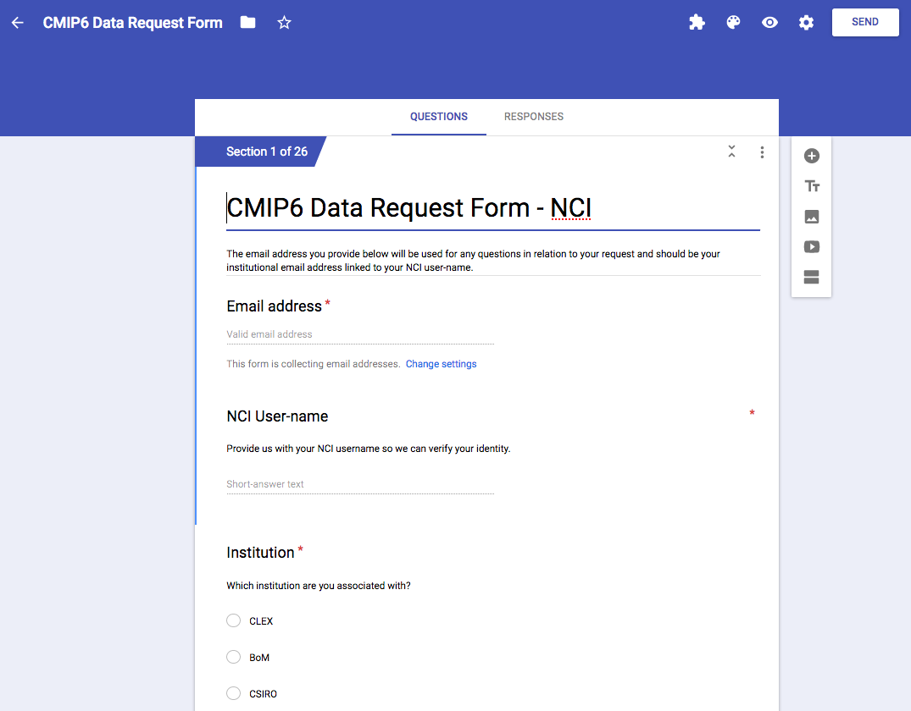
CMIP Website Download Request
Request is via a Google Forms sheet that is emailed to help@nci.org.au once complete.
Time for download may vary depending on how many other downloads are in the queue, how large the download is, and where it is coming from (some nodes are slower than others).

